Slide 1

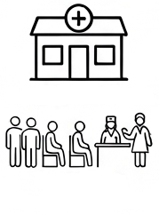
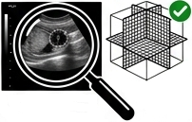


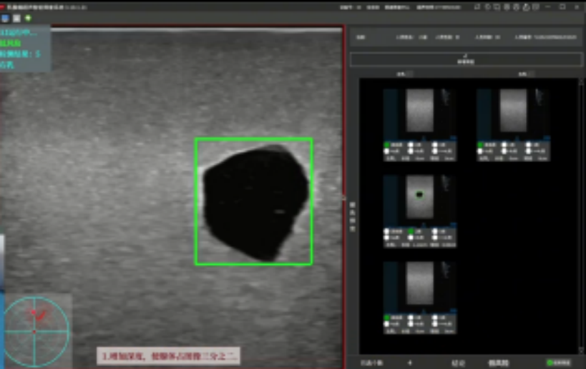


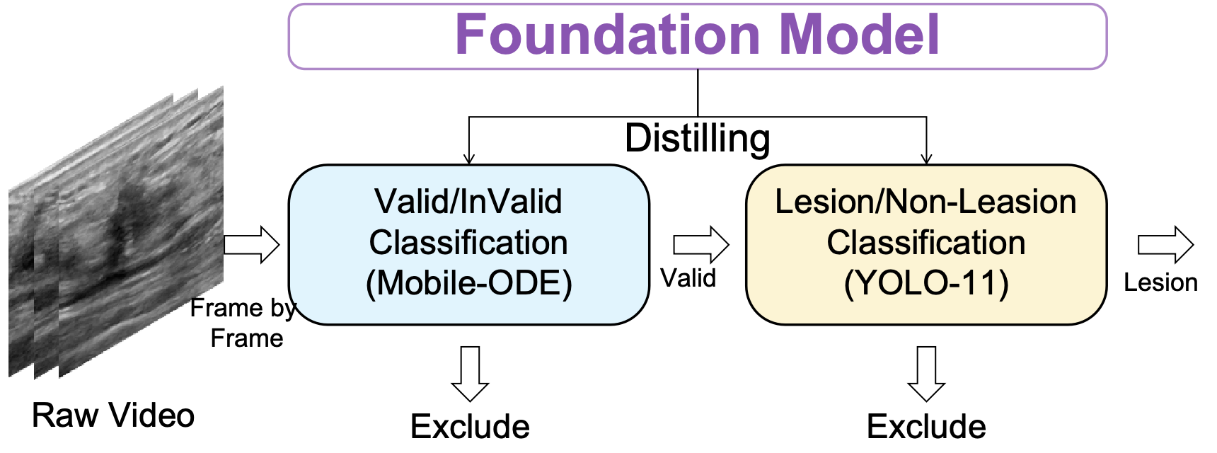
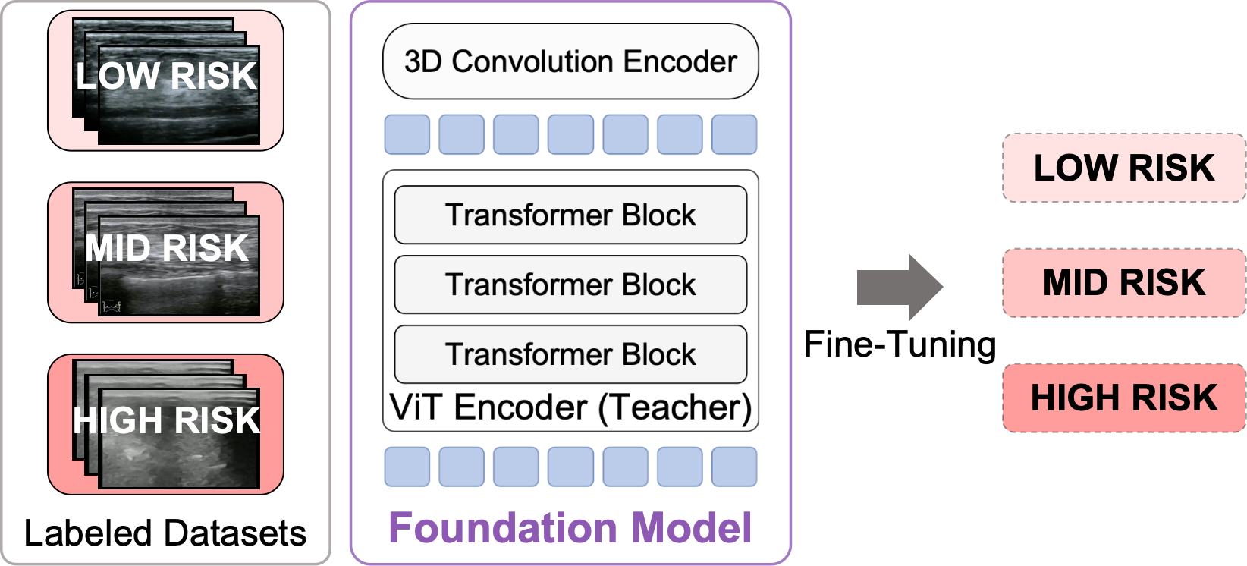



Clinical Workflow
AIBS
System
Rural Health Clinic
Community
Screening Event
Quality Control
Instructions
Technician with Portable Device
Scanning Quality Control
Preliminary
AI Results
Device-Side Models
Device-Side Display
Online Expert
Review
Final
AI Results
Report
Generation
Cloud-Side Models

Slide 2



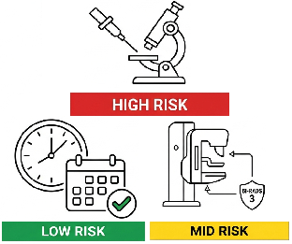

Scanning
QC
Technician & Portable Ultrasound Device
Quality
Lesion detection
Assurance
1. Technician uses portable ultrasound with QC module.
2. Point-of-care screening in rural settings.
3. Ultrasound data is processed by edge computing.
4. Cloud foundation models further analyze suspicious breast lesion videos.
5. System evaluates final outcomes
Risk Stratification
Rural Health Clinic
Clinical Workflow
Community
Screening Event
Edge
Computing

Slide 3
1. Technician uses portable ultrasound with QC module.
2. Point-of-care screening in rural settings.
3. Ultrasound data is processed by edge computing.
4. Cloud foundation models further analyze suspicious breast lesion videos.
5. System evaluates final outcomes
Technician & Portable Ultrasound Device
Quality
Assurance
Rural Health Clinic
Scanning
QC
Clinical Workflow
Risk Stratification
Community
Screening Event
Lesion detection
Edge
Computing

